Slide 1
ANALYZING AMAZON SALES DATA
Detailed Project Reports
Presentation By : Siddharth Bhat

Slide 2
PROJECT DETAILS
Project Title | Analysing Amazon Sales Data
Technology | Business Intelligence
Domain Name | E - Commerce
Project Difficulties Level | Advanced
Tools | Jupyter Notebook, Power BI, Ms-Excel, Power Point

Slide 3
OBJECTIVE
Finding The Product Sales , Revenue And Profit Trend Month Wise , Year Wise And Yearly Month Wise

Slide 4
PROBLEM STATEMENT
Sales management has gained importance to meet increasing competition and the
need for improved methods of distribution to reduce cost and to increase profits.
Sales management today is the most important function in a commercial and
business enterprise.
Do ETL : Extract-Transform-Load some Amazon dataset and find for me
Sales-trend -> month wise , year wise , yearly month wise Find key metrics
and factors and show the meaningful relationships between attributes.
Do your own research and come up with your findings.

Slide 5
ARCHITECTURE
Importing Libraries Jupyter Notebook
Real Word
Raw Data Collection
Load Dataset
Data Cleaning
Deployment
Insights
Power BI Desktop
Modelling
Data Analysis
Reporting

Slide 6
DATASET INFORMATION
This is a Sales related dataset that contains Information like Total Cost, Total Profits, Unit Cost Price, Unit Sold, Unit Price, Total Revenue, Sales Channel

Slide 7
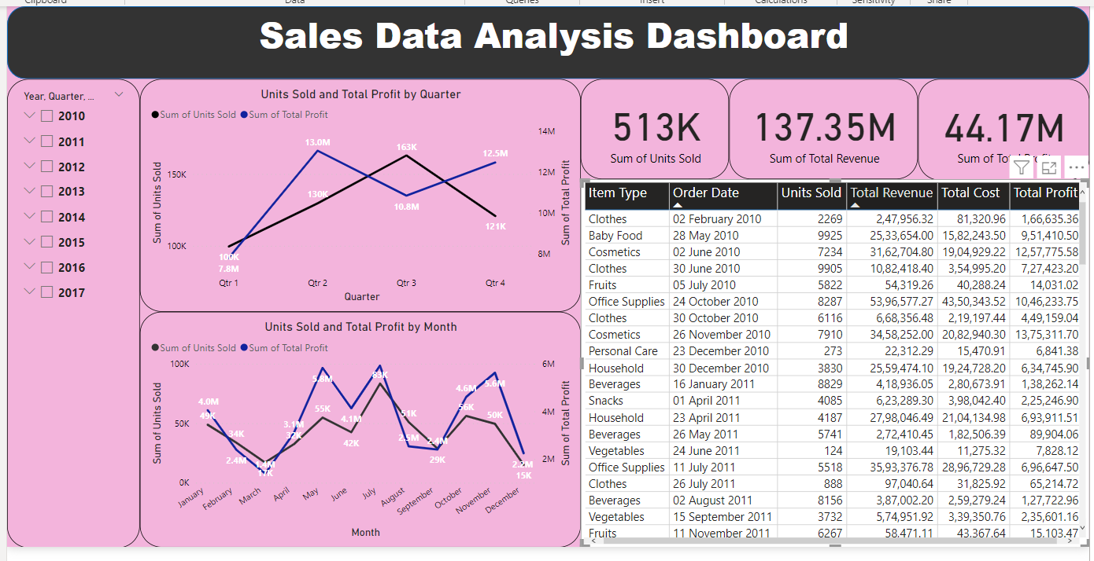
DASHBOARD

Slide 8
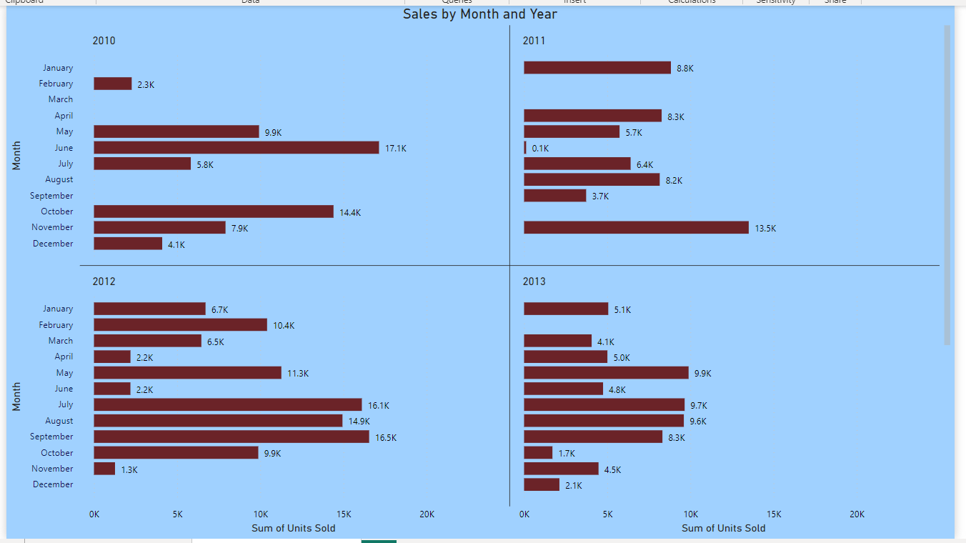
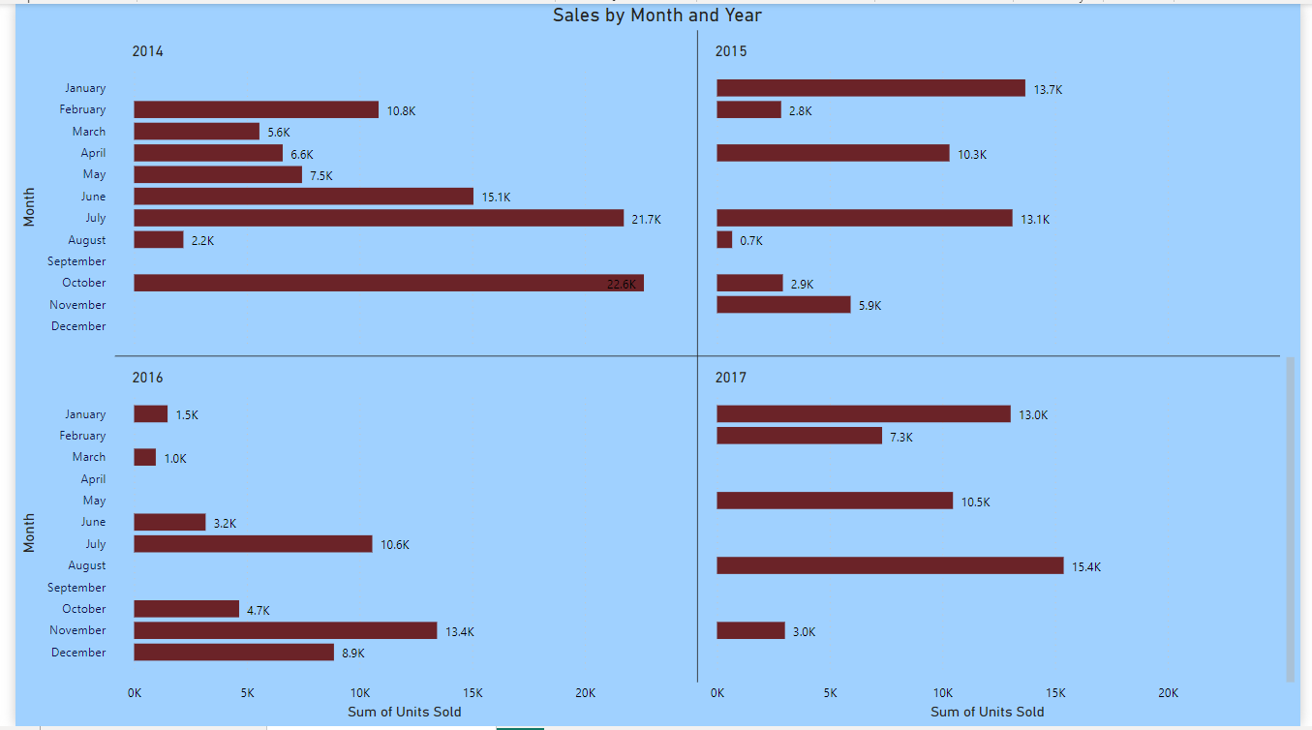
SALES BY YEAR WITH MONTH WISE

Slide 9
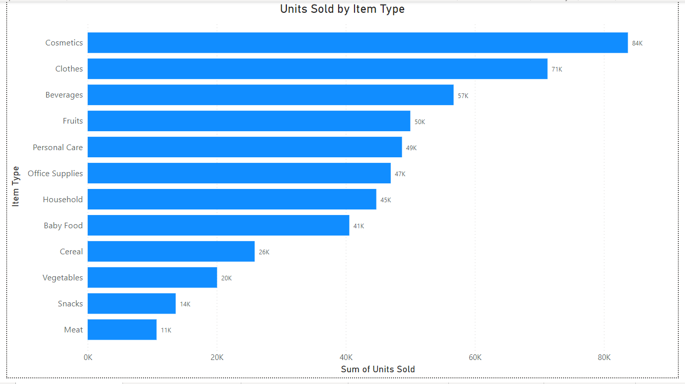
SALES BY ITEM TYPES WISE

Slide 10
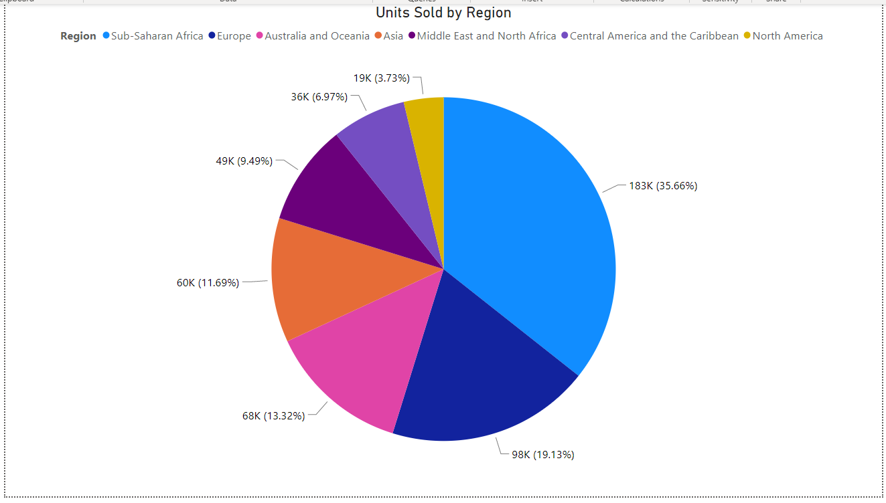
SALES BY REGION WISE

Slide 11
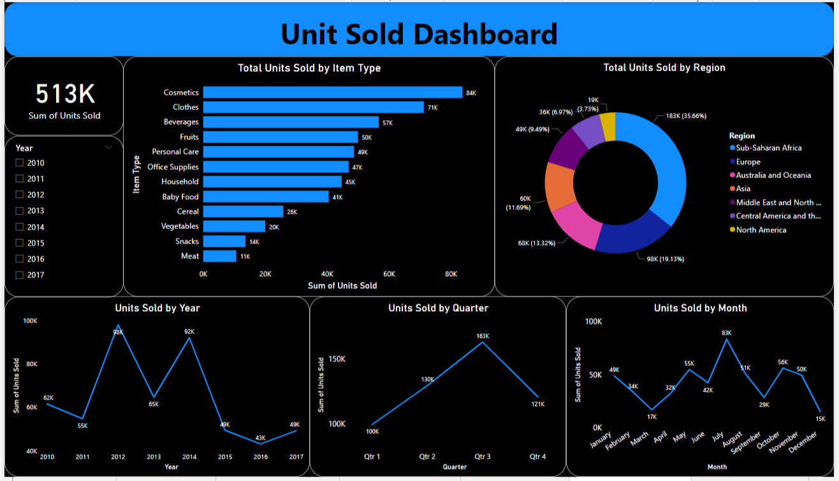

Slide 12
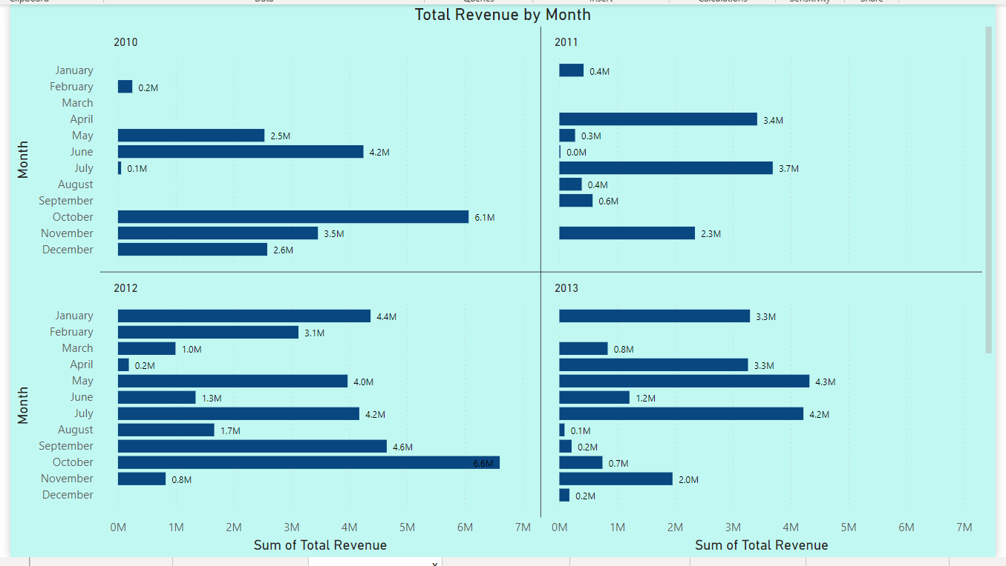
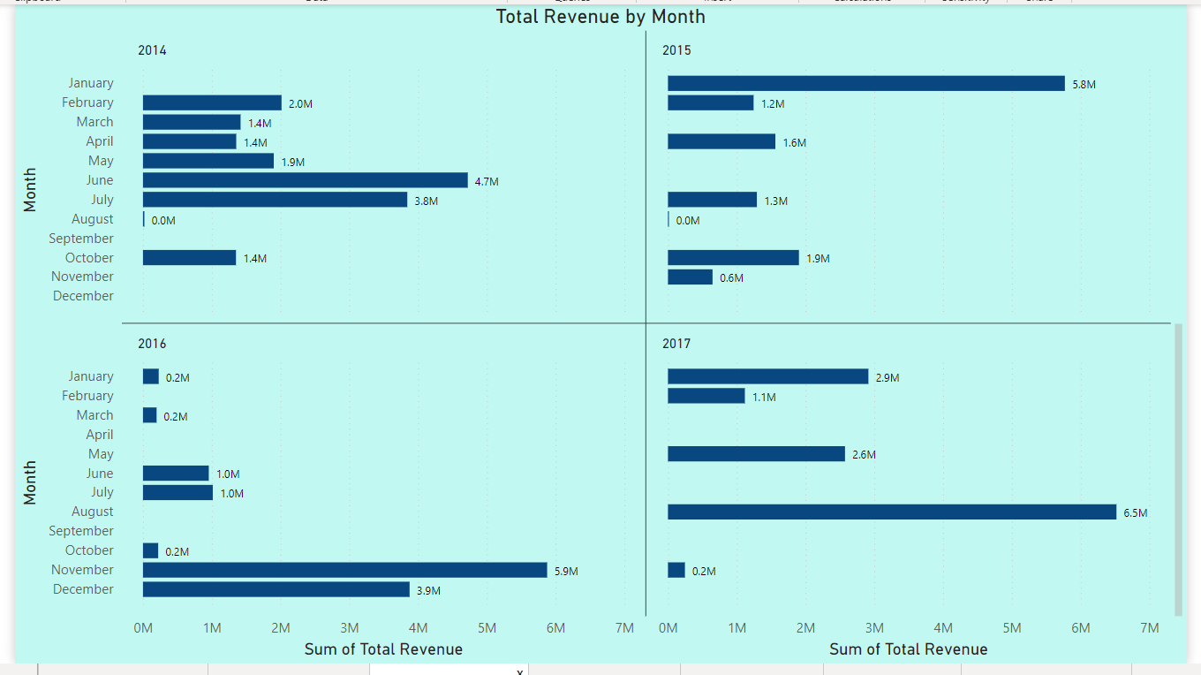
REVENUE BY YEAR WITH MONTH WISE

Slide 13
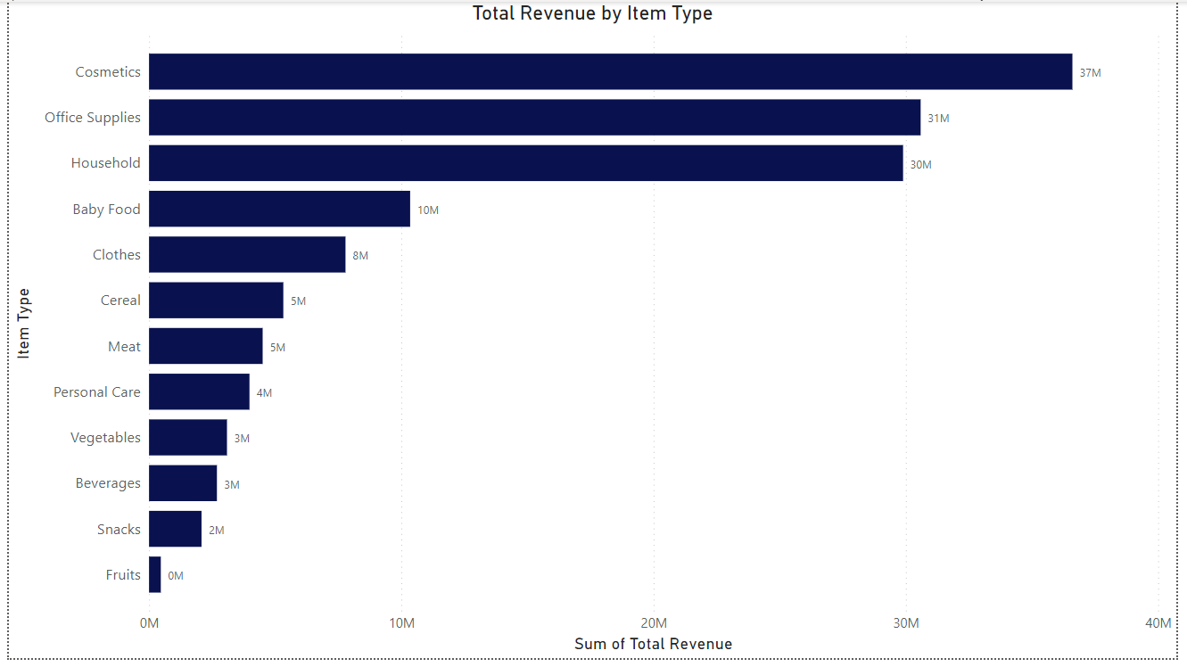
REVENUE BY ITEM TYPES WISE

Slide 14
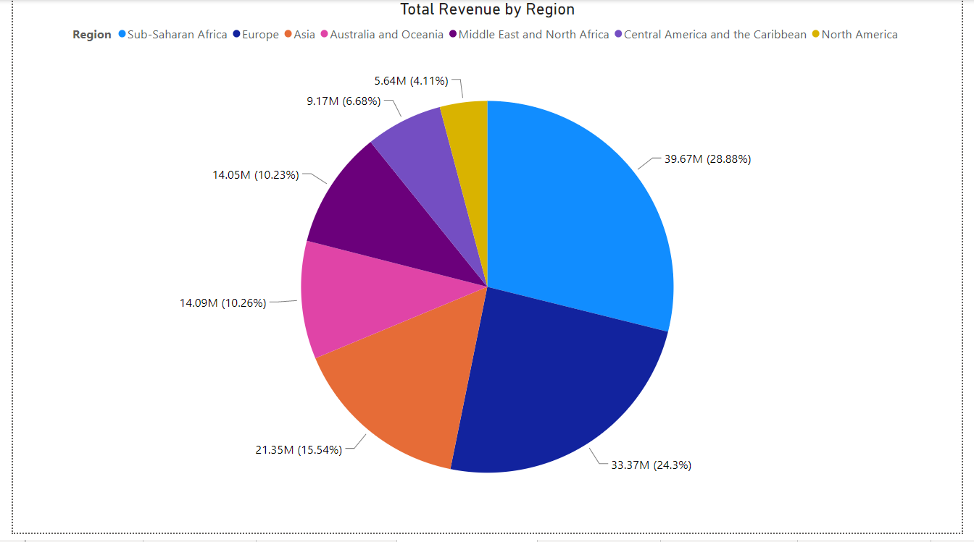
REVENUE BY REGION WISE

Slide 15
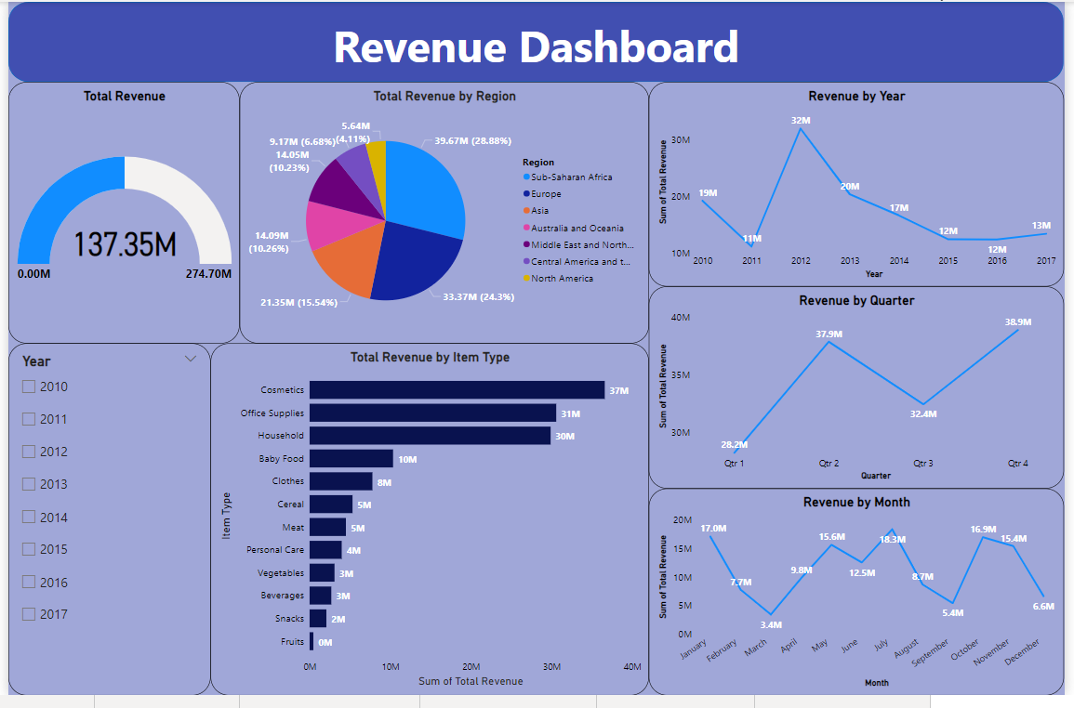

Slide 16
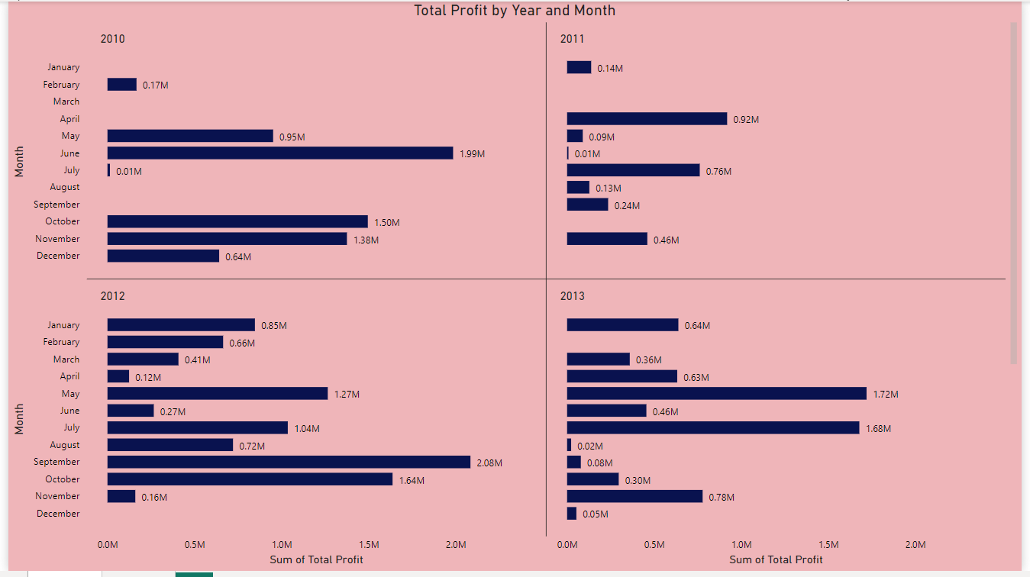
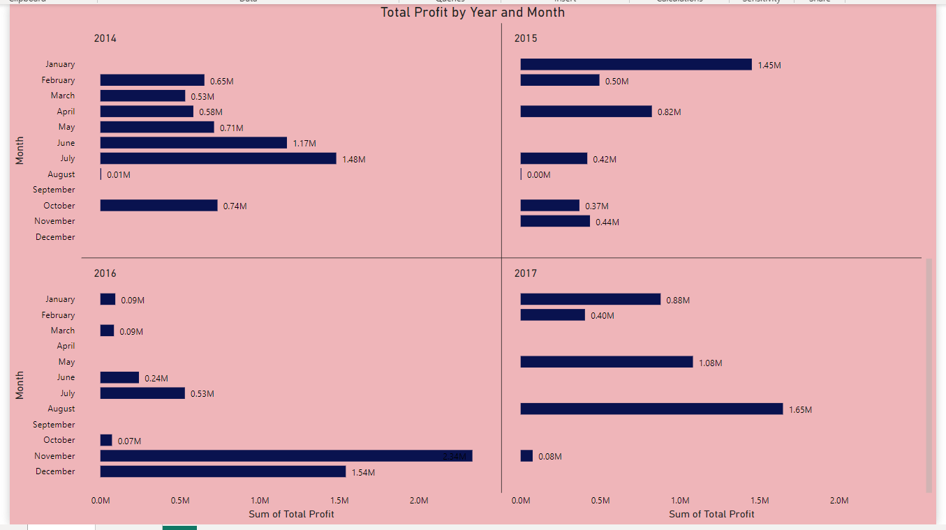
PROFIT BY YEAR WITH MONTH WISE

Slide 17
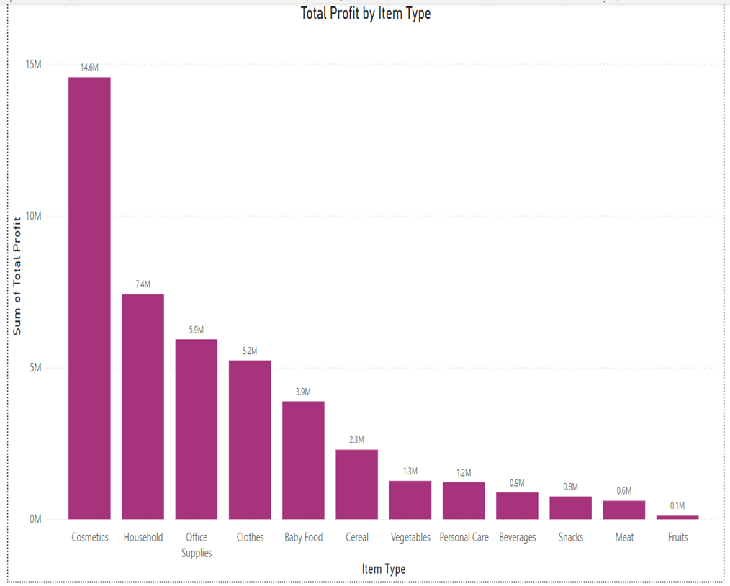
PROFIT BY ITEM TYPES WISE

Slide 18
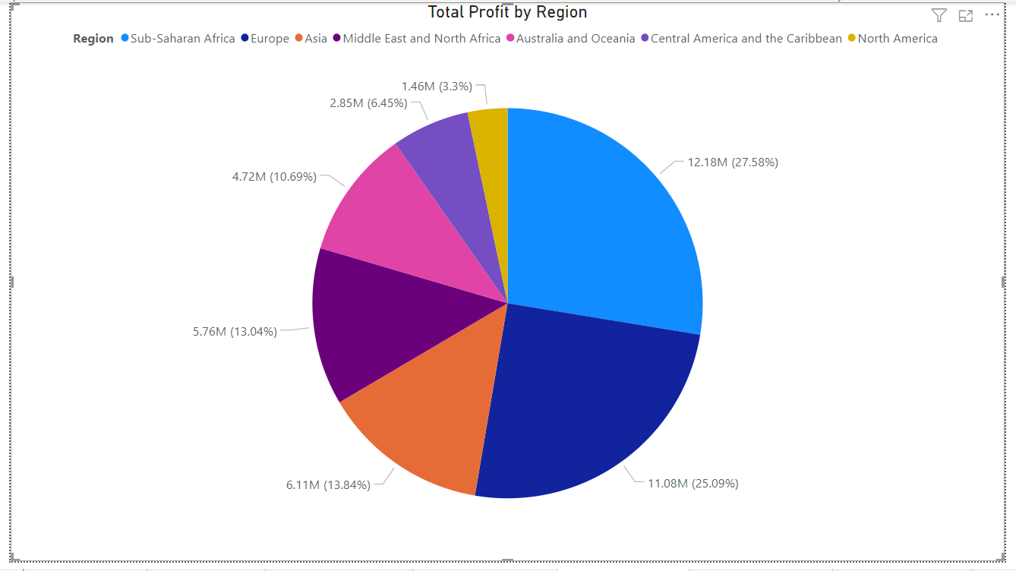
PROFIT BY REGION WISE

Slide 19
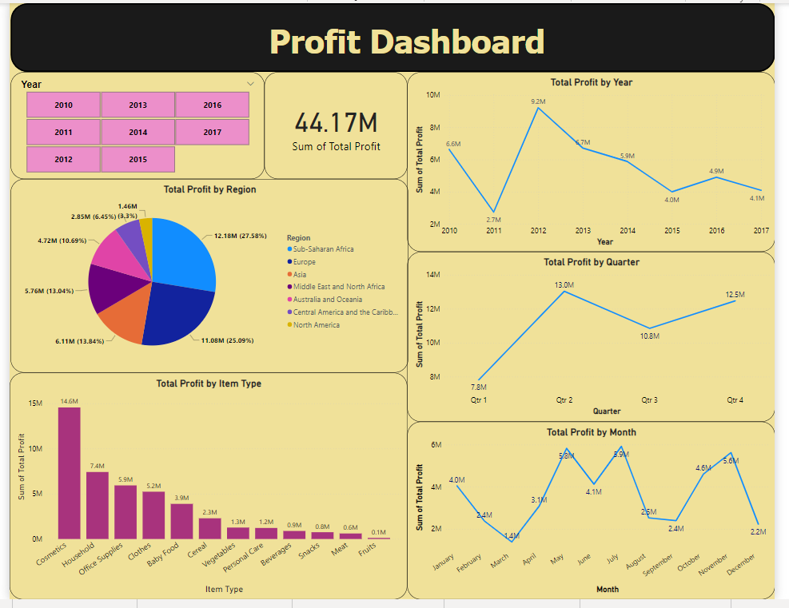

Slide 20
QUESTIONS AND ANSWERS
Q1) What’s the source of data?
Ans) The Dataset was taken from iNeuron’s Provided Project Description Document.
https://drive.google.com/file/d/1tvNcSh1Ayfkv7NIE2oKqIMOLlfedNJvM/view
Q2)What was the type of data?
Ans) The data was a combination of numerical and Categorical values.
Q 3)What was the complete flow you followed in this Project?
Ans) Refer slide 11th, 15th and 19th for better Understanding
Q4) What techniques were you using for data?
Ans) Removing unwanted attributes.
Visualizing relation of independent variables with each other and output variables.
Checking and changing distribution of continuous values.
Removing outliers and Cleaning data are present.
Transforming data to yield the desired result.

Slide 21
THANK YOU

